Slide 1
Terms:
Software
Set of instructions
aka programs
Operating System:
Special software whose job it is to translateinstructions into hardware instructions
Programs are written using programming languages.

Slide 2
Programming Languages
Machine Language Assembly Language High-Level Language
Machine language
a set of primitive instructions built into every computer
binary code
programming with native machine language is:
tedious,
error prone,
highly difficult to read and modify
For example, to add two numbers, you might write an instruction in binary like this:
1101101010011010

Slide 3
Programming Languages
Machine Language Assembly Language High-Level Language
Assembly Language
designed to make programming “easier”
“readable” text representation of machine language
an assembler converts assembly language to machine language
For example, to add two numbers, you might write an instruction in assembly code like this:
ADDF3 R1, R2, R3

Slide 4
Programming Languages
Machine Language Assembly Language High-Level Language
High-Level Language
English-like and much easier to program
“readable” text representation of machine language
We must convert the high-level language to a language closer to machine language
Compilers
Java uses a compiler
Interpreters

Slide 5
Programming Languages
Machine Language Assembly Language High-Level Language
Compiler
a compiler translates high-level language to an intermediate level
Could be: “object code”
created to allow linking to libraries
Could be: assembly language
Java compilers translate to a cross-platform assembly language.
Each computer then has a custom Java Virtual Machine program that interprets the code at run-time and issues machine instructions.

Slide 6
Why Java?
Free!
Lots of support and use
Google, Android, Oracle
Java has been around for over 20 years
And is only getting more popular!
Platform Independent
OOP
One of the few almost completely oop languages
Powerful development environment
Eclipse
“James Gosling invented Java, Bjarne Stroustroup invented C++, Dennis Ritchie invented C, and Bill Gates invented nothing. Yet, who’s the richest of the bunch?”

Slide 7
Start writing Java Code:
EVERYTHING must be in a class
To start:
Create a new file with the same name as the class you are going to create (and the .java extension) (e.g., NewClass.java)
Inside the new file, create the class:
public class NewClass {
}
Inside the class, you can place a method called main that will run automatically when you run the file:
public class NewClass {
public static void main(String[] args) {
…Code for main function goes here
}
}
NOTE! With Java, every program must have a main function (and only one main function). This is where your code starts running from!

Slide 8
Two big syntax differences
Java uses the C/C++ code block syntax
{ and } around code that goes together, e.g.,
if (x == 3) {
Code that happens when x is equal to 3 goes here
}
Java has type declaration as part of the syntax
You must tell the compiler what type your variables and parameters are
The compiler sets aside space in memory ahead of time. It must know how much space to set aside.

Slide 9
Blocks
braces must go around blocks of code
A semicolon separates each line of code.
Python
the colon (:) and indentation create blocks
newlines separate components
Racket
parens () define blocks.
Special functions over lists define a sequence of program components, (begin ...), (local ...)

Slide 10
Types
Types are included on variable and parameter declaration
public class Test {
public static void main(String[] args) {
int a = 5 + 10;
System.out.println(a);
}
}
type
type

Slide 11
Numerical Data Types

Slide 12
Numeric Operators

Slide 13
A simple program
Write a function that computes the area of a circle:

Slide 14
Trace a Program Execution
allocate memory for radius
public class ComputeArea {
/** Main method */
public static void main(String[] args) {
double radius;
double area;
// Assign a radius
radius = 20;
// Compute area
area = radius * radius * 3.14159;
// Display results
System.out.println("The area for the circle of radius " +
radius + " is " + area);
}
}
radius
no value

Slide 15
Trace a Program Execution
public class ComputeArea {
/** Main method */
public static void main(String[] args) {
double radius;
double area;
// Assign a radius
radius = 20;
// Compute area
area = radius * radius * 3.14159;
// Display results
System.out.println("The area for the circle of radius " +
radius + " is " + area);
}
}
assign 20 to radius
radius
20
area
no value

Slide 16
Trace a Program Execution
public class ComputeArea {
/** Main method */
public static void main(String[] args) {
double radius;
double area;
// Assign a radius
radius = 20;
// Compute area
area = radius * radius * 3.14159;
// Display results
System.out.println("The area for the circle of radius " +
radius + " is " + area);
}
}
memory
radius
20
area
1256.636
compute area and assign it to variable area

Slide 17

Trace a Program Execution
animation
public class ComputeArea {
/** Main method */
public static void main(String[] args) {
double radius;
double area;
// Assign a radius
radius = 20;
// Compute area
area = radius * radius * 3.14159;
//alternative: Math.pow(radius,2) * 3.14159;
// Display results
System.out.println("The area for the circle of radius " +
radius + " is " + area);
}
}
memory
radius
20
area
1256.636
print a message to the console

Slide 18
Types
Java compiler tries to be efficient.
It sets aside space in memory ahead of time for parameters, return values, variables.
For every variable, parameter, and return value, you MUST specify the type!
E.g.,
public static int functionname(double x, String y) {
…
}

Slide 19
Character Data Type
char letter = 'A'; // a new type – for a single character
// note the single quotes!!!
Also (we rarely use…):
char numChar = '4';
char uletter = '\u0041'; (Unicode) //4 hex numbers make a char.
char unumChar = '\u0034'; (Unicode)
Description Escape Sequence Unicode
Tab \t \u0009
Linefeed \n \u000A
Carriage return \r \u000D
Backslash \\ \u005C
Single Quote \' \u0027
Double Quote \" \u0022

Slide 20
The String Type
String message = "Welcome to Java";
Strings are just an array of chars
We’ll talk about arrays later,
+
“operator overloaded”
Numbers get added
Strings get concatenated
“adding” non-String types to an existing String will invoke the toString method that converts the non-String type to a String
String s = “5” + 6;
// s now has the String value “56”
String r = “five” + “six”;
// r now has the String value “fivesix”

Slide 21
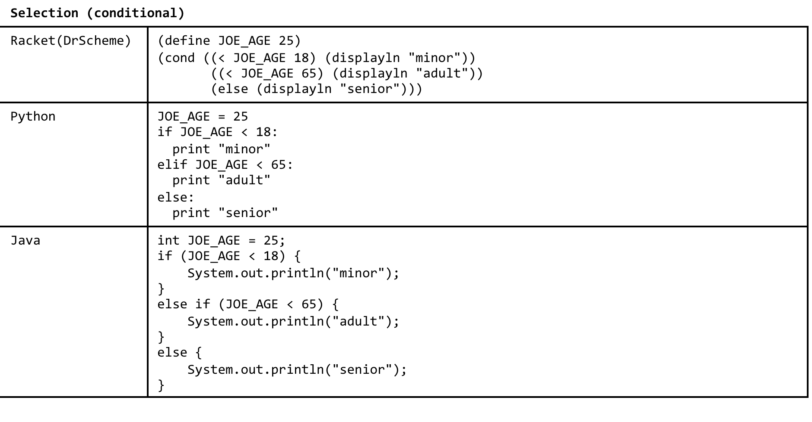
Branching

Slide 22
The boolean Type
Boolean Values are: true and false
boolean b = (1 > 2); // b is the value false
boolean even;
if (number%2 == 0) {
even = true;
}
else {
even = false;
}
boolean even = (number%2 == 0);

Slide 23
TIP
if (even == true) {
System.out.println(“It is even.”);
}
Same as:
if (even) {
System.out.println(“It is even.”);
}

Slide 24
Logical Operators
Java Name
! not
&& and
|| or
^ exclusive or

Slide 25
What do we get?
boolean b = 3 == 2*4;
boolean d = !b;
if (d) {
System.out.println("snow day");
}
else {
System.out.println("Just rain");
}

Slide 26
Conditional Operator
if (x > 0) {
y = 1;
}
else {
y = -1;
}
is equivalent to
int y = (x > 0) ? 1 : -1;
(boolean-expression) ? expression1 : expression2
y = (true)? then y becomes expression1
y = (false)? then y becomes expression 2

Slide 27
int k = 7;
int m = 5;
String y= ((21%k!=0) || (21%m!=0)) ? "Echidnas":"Wombats";
System.out.println(y);

Slide 28
Types in Java:
Assume that int a = 1 and double d = 1.0. What is the result of the following expression?
a = 46 / 9;
46
6
5
0

Slide 29
Java:
Assume that int a = 1 and double d = 1.0. What is the result of the following expression?
a = 46 % 9 + 4 * 4 - 2;
8
0
19
15

Slide 30
Java:
Assume that int a = 1 and double d = 1.0. What is the result of the following expression?
a = 46 / 9 + 4 * 4 - 2;
8
0
19
15

Slide 31
Types in Java:
Assume that int a = 1 and double d = 1.0. What is the result of the following expression?
d = 1.5 * 3 + a;
5.5
5
6
6.0

Slide 32
Java Methods
Methods – like functions but inside of classes.
Because everything must be in a class in Java, everything is technically a method
E.g.,
public static int max(int x, int y) {
int result;
if (x > y) {
result = x;
}
else {
result = y;
}
return result;
}
//Call method
public static void main(String[] args) {
System.out.println(max(3,7));
}

Slide 33
public static int max(int x, int y)
Method header:
public – available to classes other than the one it’s in.
static – don’t need to create an instance of the class to access the method (static- sticks around)
we’ll discuss these more later when we start using classes
int max – this function returns a value that is of the type int
If a function doesn’t return a value, then the type returned is void, e.g.,
public static void NoReturn(int x) {
}
The function’s name is max
(int x, int y) – this method has 2 parameters, x, and y, and both x and y are of type int.

Slide 34
public static int max(int x, int y) {
int result;
if (x > y) {
result = x;
}
else {
result = y;
}
return result;
}
Or
public static int max2(int x, int y){
int result = (x > y) ? x : y;
return result;
}
int result – creating a variable called result, and it is of type int. (setting aside an int’s worth of memory space for the variable result)
return result – the value that is inside of the variable result is what comes out of the function and is what can be used by what called the function.

Slide 35
//Call method
public static void main(String[] args) {
System.out.println(max(3,7));
}
Or, as an alternative:
//Call method
public static void main(String[] args) {
int retvalue;
retvalue = max(3,7);
System.out.println(retvalue);
}
max(3,7)– 3 and 7 are the parameter values – 3 goes into x and 7 goes into y
System.out.println(max(3,7)); – prints out the value that is returned from the method max, called with the values 3 and 7.
int retvalue;
retvalue = max(3,7); - we know the value being returned from the method max is an int (because that’s how we defined the max method). So we can create a variable that is of type int to hold the value returned from max.

Slide 36
Looping (Iteration)
repeating a process
usually toward a stopping condition
In a program this is typically accomplished by a
loop counting variable,
stopping condition
and then the loop code
Code that happens again and again

Slide 37
Sum numbers from 1 to 10 (Python)
Loop counting variable
def sum_accum(i, limit):
total = 0
while (i < limit):
total = total + i
i = i + 1
return total
print (sum_accum(1, 10))
stopping condition
Loop
code

Slide 38
Sum numbers from 1 to 10 (Racket)
stopping condition
Loop counting variable
loop
(define (sum-accum i limit total)
(cond [(>= i limit) total]
[else (sum-accum (+ i 1) limit
(+ total i))]))
(display (sum-accum 1 10 0))

Slide 39
Sum numbers from 1 to 10 (Java)
public static int sumAccum(int i, int limit) {
int total = 0;
while (i < limit) {
total = total + i;
i = i + 1;
}
return total;
}
public static void main(String[] args){
System.out.println(sumAccum(1,10));
}
stopping condition
Loop
code
Loop counting
variable

Slide 40
Indefinite Loops
A repetition structure that executes code while a condition is true
We don’t know ahead of time how many times the loop will happen
import java.util.Random; // at top of file
...
int guess = 1;
Random r = new Random(); //must make an object of type random
while (guess % 7 != 0) {
guess = r.nextInt(100); //gets a random int between 0 and 100
}
System.out.println(guess);

